Slide 1
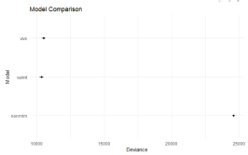
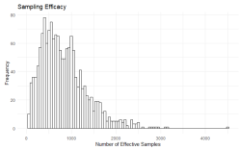
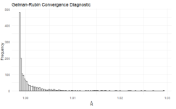
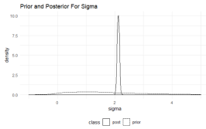
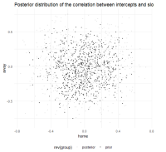
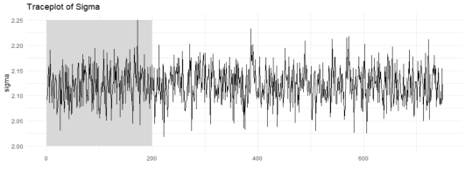
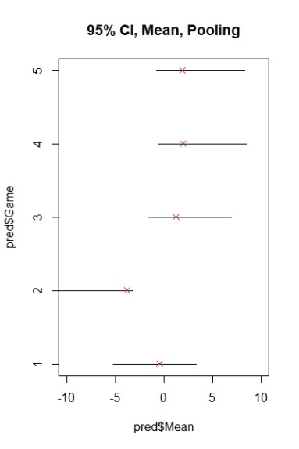
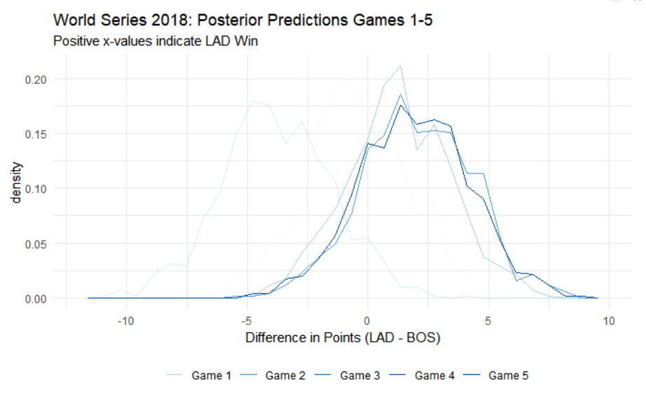
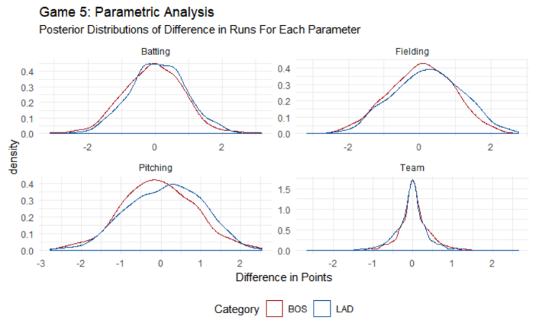
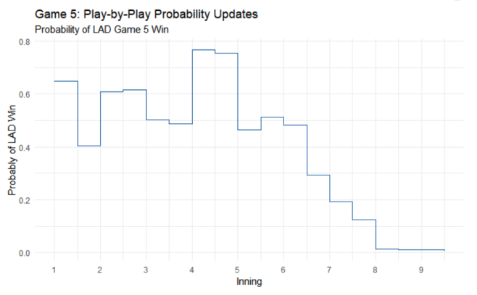
Model Comparison Compared to a varying-intercept only model, the varying intercept/slope model has higher mean WAIC, however, the mean difference is not significant. Furthermore, as varying intercept/varying slope model fits has a lower in-sample deviance score. This is due to having more parameters in the model. Both multi-level models outperform a single-level regression with uniform priors.
Model Diagnostics Computational approximation of posterior distributions was executed using Hamiltonian Monte Carlo with a No-U-Turn sampler, executed in the software Stan. There was only 1 divergent transition and all parameters have an Rhat of 1.00 or 1.01, indicating precise estimation of all parameters.
Bayesian Baseball- World Series 2018
Blake Shurtz, blakeobeans@gmail.com
This poster presents and analyzes a model that predicts the outcome of baseball games with a focus on game 5 in the 2018 World Series between the Boston Red Sox (BOS) and the Los Angeles Dodgers (LAD).
The Model
Two Factor Model The model is an i=2 two-factor model that predicts the difference in runs (“rundiff”) between the home team and away team, whereby a positive value for rundiff represents a win for the home team. The benefits of using a two-factor structure include a consistently defined outcome variable for all possible games, thereby allowing all data to be organized into a single data set.
Multi-Level Model There are j=2 two levels to the model. The game level contains statistical predictors in batting and pitching as well as the response. The team level contains varying intercepts for each team and performance statistics in fielding. The multi-level model allows for partial pooling whereby the predicted outcome for each game is balanced between the previous matches between the two teams and each team's overall performance for the season.
Varying Intercepts / Varying Slopes The model allows for differences in offensive vs. defensive performance for all possible teams.
Bayesian Framework The model is analyzed in a Bayesian framework with a maximum entropy Gaussian likelihood function. Fielding variables are scaled with standard normal priors and all other predictors have adaptive priors that are themselves a function of the data. The priors for the variances have half-Cauchy distributions. The prior for the correlation matrix between intercepts and slopes is a LKJ "onion method“ distribution.
World Series 2018: Posterior Predictions Games 1-4 Prior to the 2018 World Series, BOS and LAD had never played a match. Nevertheless, we can simulate games with team-level effects where all of the game-level predictors are zero. In other words, we can simulate the game up until the point that it starts. After each match, the model is updated with the results from the previous game.
World Series 2018: Posterior Prediction Game 5 LAD hosts game 5 with a 1-1 record at home. The model predicts a 65% probability that LAD wins game 5. Nevertheless, LAD has only a 27% binomial probability of winning the necessary 3 games out of 3 for the pennant.
Game 5: Parametric Analysis The model has been reparameterized in order to simulate posterior distributions for team effects and batting, pitching and fielding performance. While BOS is a overall a slightly better team than LAD (-.05 pts), LAD shows superiority in batting,(.14 pts), pitching (.12 pts) and especially fielding (.17 pts).
Game 5: Play-by-Play Probability Updates Due to the game-level nature of the response and the observability of the predictors, game 5 outcomes can be predicted in real-time. The model begins with the prior probability of a 65% chance of success for LAD. Both teams score early runs and LAD stays above p=50% due mainly to the higher batting average through inning 4. However, Boston scores 3 consecutive runs in innings 6, 7, and 8, securing the pennant with near certainty by inning 8.

